Slide 1
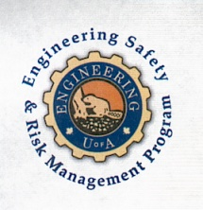
On Becoming a Leader in Risk Management
Fundamentals of RM
RM System and Process
Leadership in RM
Incident Investigation
RM Tools & Challenges
RM in Industry
People & Org.
Applications & Perspectives
ENGG404 Lecture
Chapter 6.1: Process Safety Management Overview
1
Notes:
ENGG404 Lecture 00 - Day 1
2012 Fall
1
1

Slide 2
Learning Outcomes
Explain the difference between occupational safety and process safety.
Explain process safety and incident investigations in the context of other engineering disciplines.
Apply the concept of process safety to an industrial example.
Chapter 6.1: Process Safety Management Overview
2
Notes:
2

Slide 3


Introduction
Occupational safety generally refers to worker injuries, such as prevention of trips, slips and falls.
Process safety includes the prevention of unintentional releases of chemicals, energy, or other hazardous materials.
Typical “process hazard” or “process safety hazard” definition:
Asset: Physical situation where the activity is taking place (i.e. the facility, equipment)
Potential impact: Harm or damage to PEAP
Trigger: A release of energy
Energy Source: Nature of the materials (flammable, combustible, toxicity, corrosive)
Where 1 might create 2 through 3 from 4.
Recall the Discovery Approach!
Chapter 6.1: Process Safety Management Overview
3
3

Slide 4

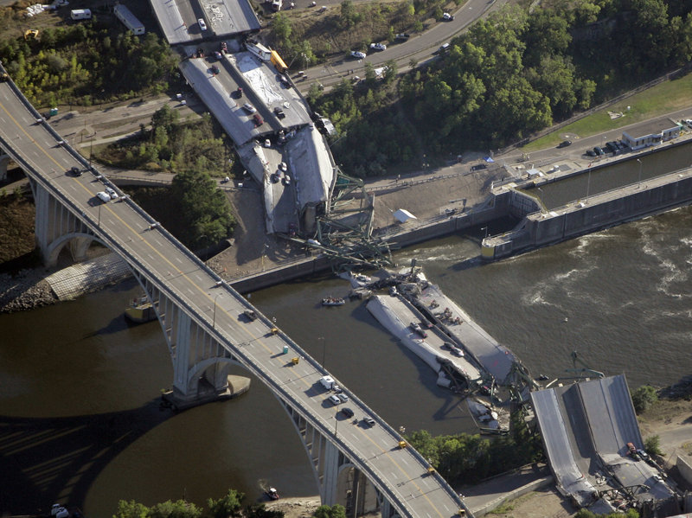
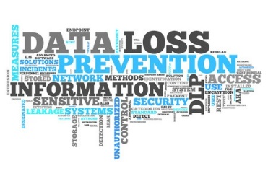
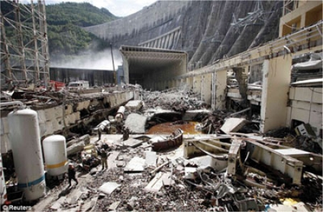
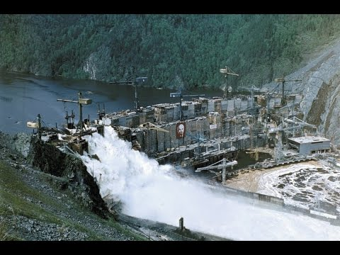
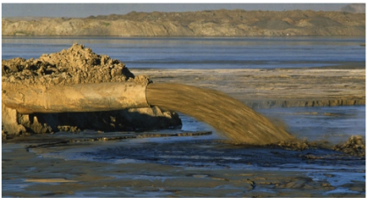
Process Safety – Not Just for Chemical Engineers!
The loss of the integrity of the engineered system that would have the equivalent magnitude or impact of a “process safety loss incident.
Loss of Containment:
Tailings from a tailings pond
Sewage from a sludge line
Private data from a server
Hydrocarbons from a train car
Slope failure of a roadway
Loss of Integrity of Eng’d Systems:
STS Challenger & Columbia
Exxon Valdez
Boeing 737MAX
Bridge collapses
Dam failures
Train derailments
Chapter 6.1: Process Safety Management Overview
4

Slide 5
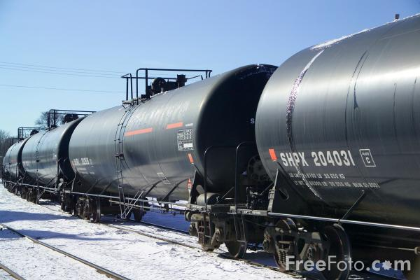
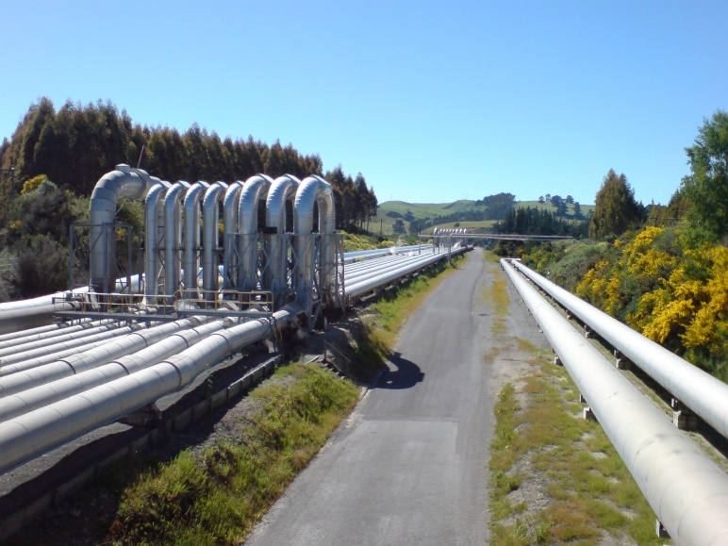
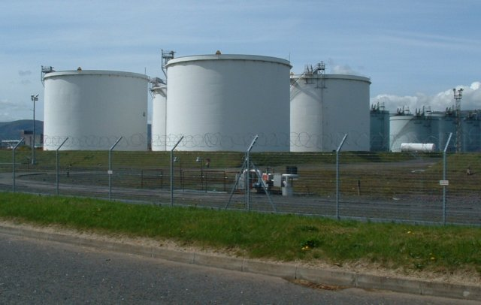
Process Safety – Not Just for Chemical Engineers!
Process safety incident investigations require expertise of many engineering disciplines (mechanical, civil, electrical, etc.)
Need to conduct a robust and thorough investigation
The key concern with a process safety incident is that the magnitude of the loss is significantly higher than occupational safety incident.
Chapter 6.1: Process Safety Management Overview
5

Slide 6
Immediate Causes of Process Safety Incidents
The potential immediate causes of process safety incidents are innumerable, some examples include:
Bypassing alarms or taking control systems offline.
Allowing substandard practices for critical procedures.
Not addressing process equipment that is in imminent failure mode, a sub-standard condition.
Chapter 6.1: Process Safety Management Overview
6
Notes:
6
However they were caught before they developed into an incident (PDCA process)

Slide 7
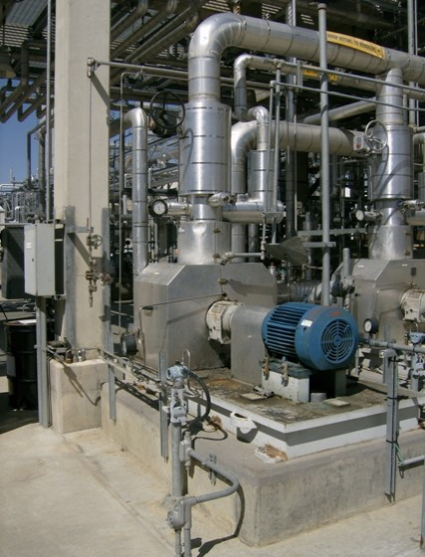
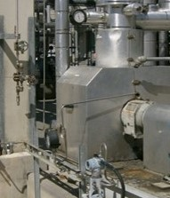
Small Diameter Tubing – Industrial / Refinery Installations
Consider small-diameter process tubing that is commonly used in many industrial process unit operations, as depicted here.
Chapter 6.1: Process Safety Management Overview
7

Slide 8
Two Incidents Involving Tubing Failure
Incident 1:
A ½-inch stainless steel tube between a glycol pump and a process vessel failed at a fitting near the process vessel.
The resulting leak sprayed onto a reboiler and ignited causing significant equipment damage.
The tubing failure was concluded to be the result of uncontrolled vibration caused by the glycol pump.
Incident 2:
Gas leak from ½-inch tubing for pump seal was detected during LNG plant startup
Deficient repairs done by unqualified technician
When the plant re-started, tubing failed completely causing an LNG leak and fire.
As a manager in these cases, what would you do?
Chapter 6.1: Process Safety Management Overview
8

Slide 9
Two Incidents Involving Tubing Failure
What should we do?
Tubing may not be as durable as pipe and may be more easily damaged. Avoid impacts to tubing and tubing connections.
Report damaged or leaking tubing observed in the plant & have it repaired (Report and correct sub-standard conditions i.e. “see it - own it – solve it”).
For design, installation, operation, maintenance:
Follow procedures for tubing identification and isolation for work.
Review procedures for installation, inspection, & maintenance of tubing.
Use qualified personnel to install and repair tubing.
Use correct tools for installation and maintenance of tubing.
Use correct components – tubing, ferrules, nuts, and fittings - do not mix components from different manufacturers.
Ask your tubing supplier to provide information on proper installation and maintenance of their product.
Chapter 6.1: Process Safety Management Overview
9

Slide 10
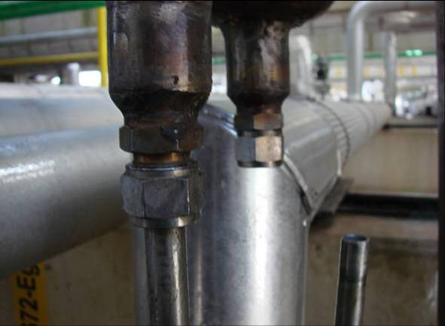
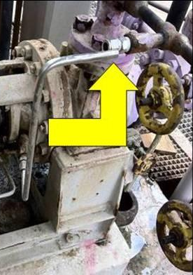
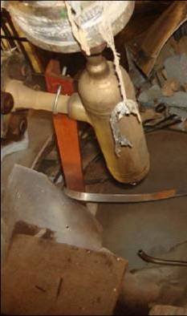
In-Class Exercise: Mechanical Integrity of Tubing
Sub-standard conditions found during inspections:
For instrument connections
To flush pump and agitator seals
For other applications with small flow requirements
Triggering events:
wrong fitting loosened; vibration fatigue failure; mis-alignment stress – forced fit or struck by; improper assembly
Chapter 6.1: Process Safety Management Overview
6

Slide 11
Summary
Differences between occupational safety and process safety:
Magnitude of the impacts on PEAP as process safety incidents are typically at least an order of magnitude worse than occupational safety incidents.
Occupational Safety LI: a worker was injured during the course of physical labour
Process Safety LI: loss of integrity of the design intent of the engineered system
Process safety is about keeping something hazardous contained and/or controlled (prevention of release).
An investigation into a process safety incident requires the expertise of various engineering disciplines (mechanical, civil, electrical, etc.)
Chapter 6.1: Process Safety Management Overview
11
Notes:
11

